Slide 1
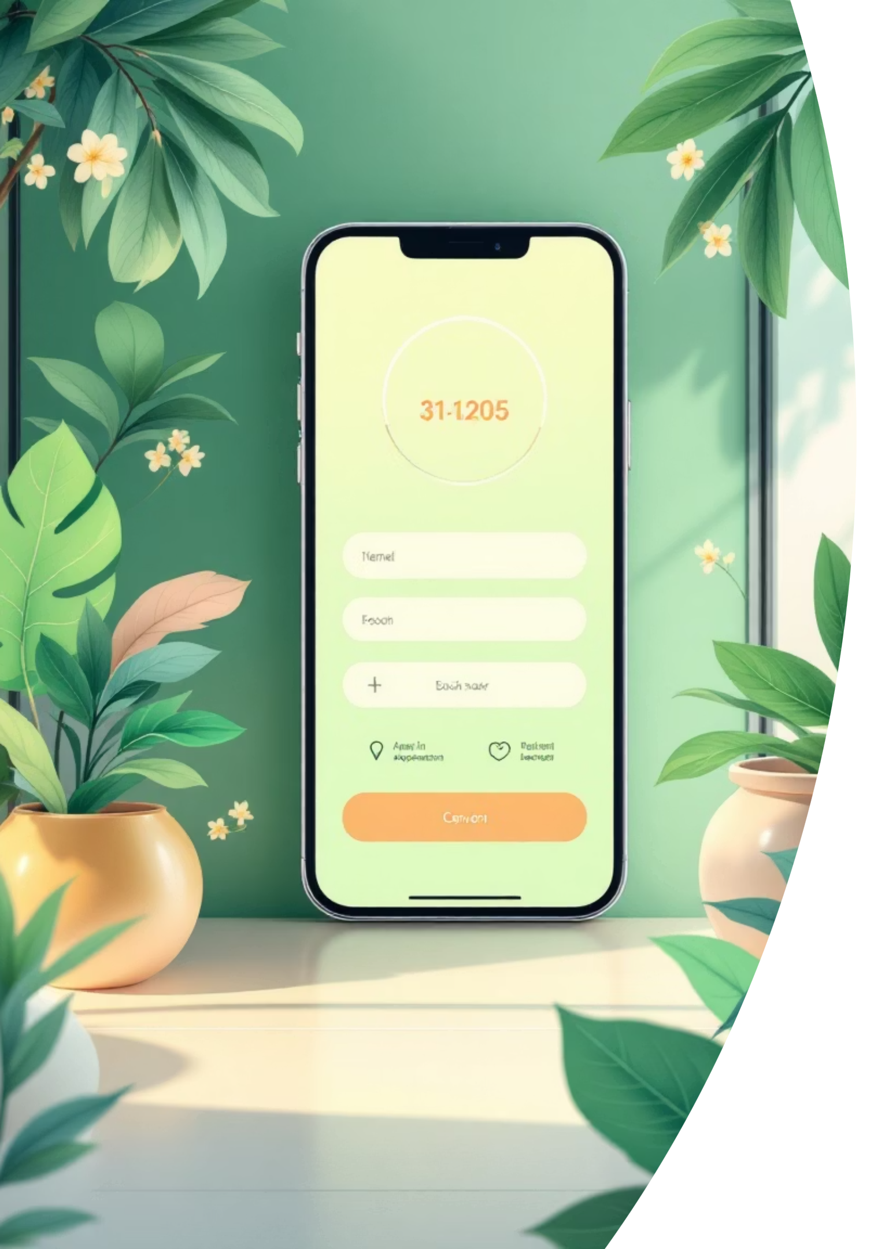
Darman: Online Hospital Appointment System
A Mobile Application for Seamless Online Appointments
Names:
Meena Yasin (1107707)
Maryam Faiz (1107476)
Sangeen Murad (1108494)
Shahgul Bashir (1108084)
Supervised by: Abdul Hakeem
Department of Computer Science University of Turbat

Slide 2

MOTIVATION
Revolutionizing Healthcare Access
The traditional manual appointment system in healthcare is notoriously inefficient, plagued by long wait times, scheduling conflicts, and frustrating patient experiences. This antiquated approach not only inconveniences patients but also places a significant burden on hospital staff.
Darman emerges as a vital solution, offering a fast, convenient, and modern online platform to transform how patients access medical care. By streamlining the appointment process, we aim to eliminate common pain points and enhance the overall healthcare journey.

Slide 3
THE CHALLENGE
Addressing the Bottlenecks in Healthcare Appointments
Manual System Inefficiencies
Patient Dissatisfaction
Resource Mismanagement
Patients frequently encounter long phone queues, limited booking hours, and a lack of transparency regarding doctor availability, creating stress and dissatisfaction.
Delays, errors, and missed appointments are rampant due to outdated paper-based or phone-call systems, leading to significant administrative overhead.
Hospitals struggle with inefficient record management and suboptimal resource allocation, impacting operational costs and quality of care.
There is an urgent need for a reliable, user-friendly online booking system that addresses these critical issues, enhancing both patient experience and hospital efficiency.

Slide 4
OUR GOALS
Core Objectives of the Darman System
Effortless Online Booking
Seamless Online Payments
Enable patients to schedule medical appointments with ease, anytime and anywhere, through an intuitive mobile interface.
Integrate secure payment gateways to facilitate convenient and instant transaction processing for appointments.
Timely Patient Notifications
Intuitive Doctor Search
Implement automated alerts and reminders to keep patients informed about their appointments, reducing no-shows.
Provide robust search and filter functionalities, allowing patients to find and select suitable healthcare providers based on specialty, availability, and location.

Slide 5
FEATURES OVERVIEW
Key Functionalities of Darman Mobile App
Secure Login & Registration
Efficient Appointment Booking
Integrated Online Payment
Personalized profiles for patients to manage their health information and appointments.
Browse doctor schedules, select preferred slots, and confirm appointments instantly.
Convenient and secure payment options for all booked medical services.
Real-time Notifications
Advanced Doctor Search
Automated reminders and updates for upcoming appointments, cancellations, and more.
Filter doctors by specialty, location, availability, and patient ratings for informed choices.

Slide 6

DEVELOPMENT STACK
Cutting-Edge Technologies Behind Darman
Flutter & Dart
Leveraging Flutter's powerful framework and Dart's efficiency for cross-platform mobile application development, ensuring a seamless experience on both iOS and Android.
Android Studio & VS Code
Utilizing industry-standard Integrated Development Environments for robust coding, debugging, and project management.
These technologies enable us to build a high-performance, visually appealing, and highly responsive mobile application.

Slide 7
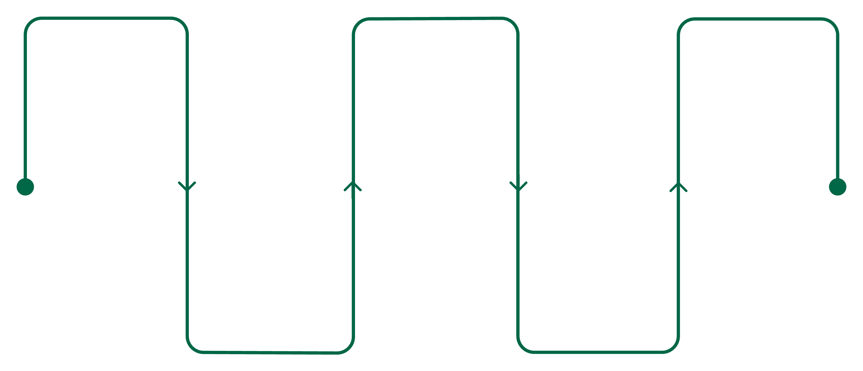
SYSTEM FLOW
Simplified Patient Journey with Darman
Login
Book
Notify
Access your Darman account
Schedule your appointment
Receive confirmation alert
Search
Pay
Find a suitable doctor
Complete secure payment
This streamlined workflow ensures a hassle-free experience, from initial login to appointment confirmation and beyond.

Slide 8
DEMONSTRATION
Darman in Action: A Visual Walkthrough
Login Screen
Booking Screen
Payment Confirmation
Notification Received
Secure and intuitive access to personalized patient profiles.
Easy selection of doctors, dates, and times for appointments.
Instant verification of successful online transactions.
Timely alerts ensuring patients are always informed.

Slide 9
DEVELOPMENT HURDLES
Overcoming Technical Challenges
Robust Notification System
Payment System Integration
Developing a scalable and timely alert mechanism for various updates.
Ensuring secure, reliable, and user-friendly payment processing.
Intuitive UI/UX Design
Crafting an interface that is both aesthetically pleasing and exceptionally easy to navigate for all users.
Cross-Platform Compatibility
Optimizing performance and consistency across different mobile operating systems.
Data Security & Privacy
Implementing strong protocols to protect sensitive patient and medical information.

Slide 10

SUMMARY
Darman: The Future of Healthcare Appointments
Problem Solved
Darman successfully addresses the inefficiencies and frustrations of manual hospital appointment systems.
Enhanced Efficiency
The application streamlines booking, payments, and notifications, creating a highly efficient process for both patients and providers.
User-Friendly Experience
Patients benefit from a fast, reliable, and intuitive platform designed for ease of use and convenience.
Darman is poised to transform healthcare access, making hospital appointments genuinely efficient and convenient for everyone.

